Slide 1
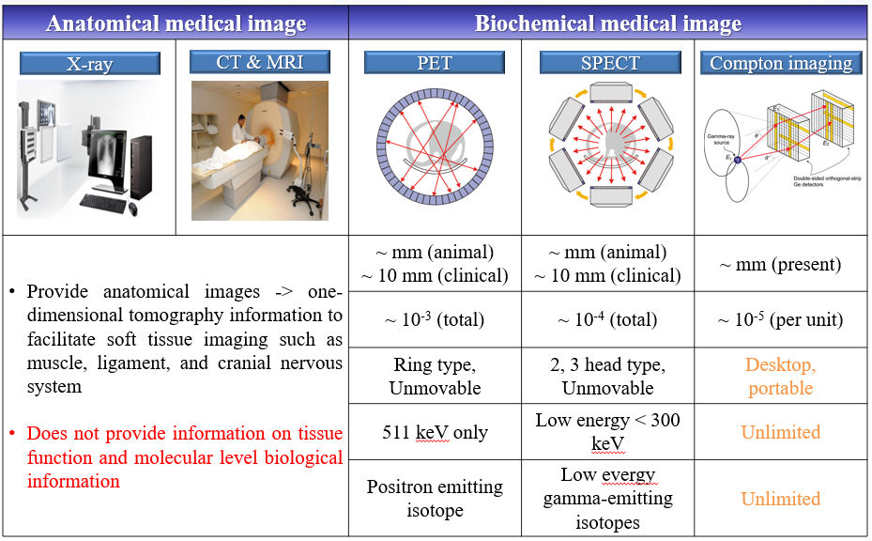
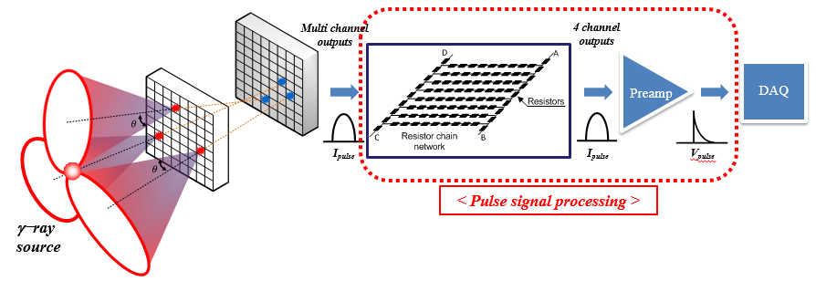
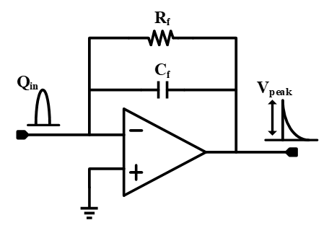
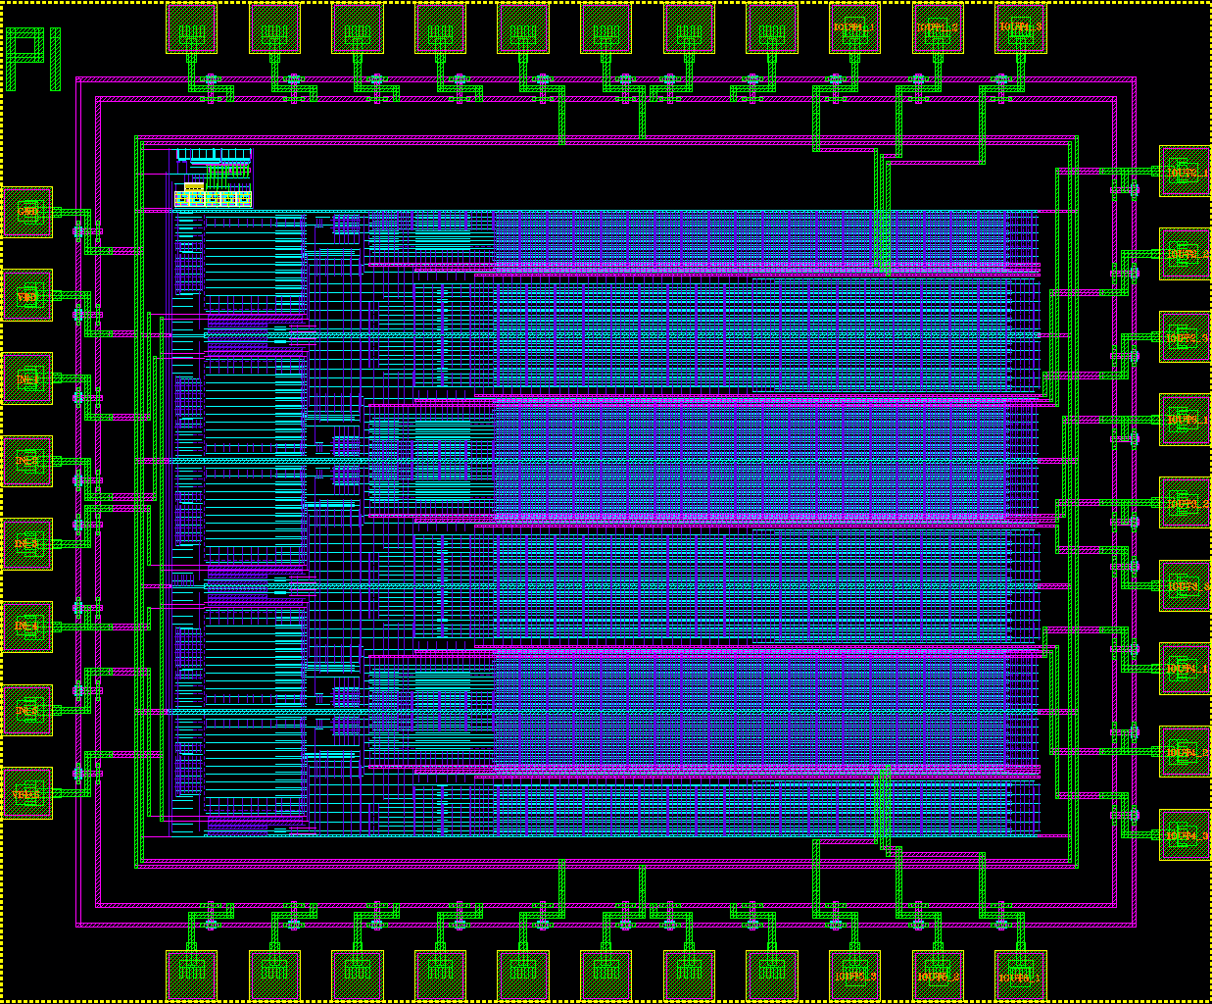
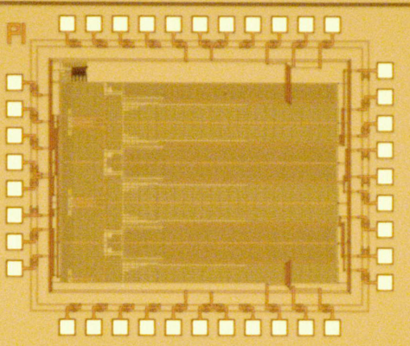
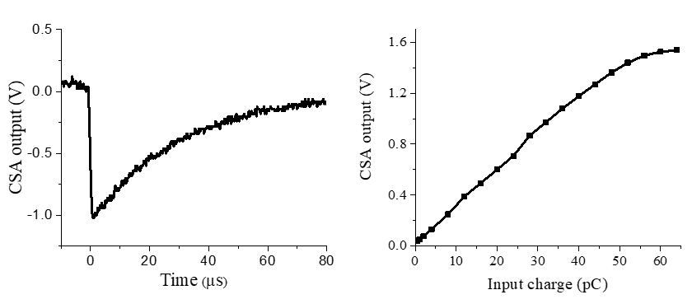
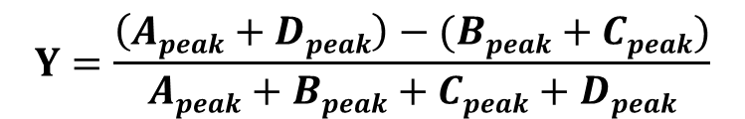
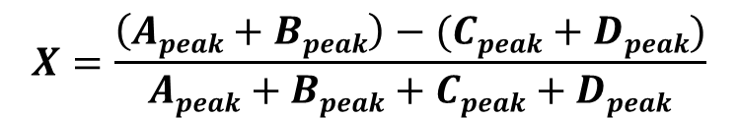
Charge Sensitive Amplifier for Pulse Signal
Processing in Gamma-Ray Detection
Su-Jin Jeon, Jae-Sang Lee, Seok-Ho Hong, Yong-Jin Kim and Young-Wan Choi
Department of Electrical and Electronics Engineering, Chung-Ang University, Seoul 156-756, Korea
ychoi@cau.ac.kr
Nuclear medicine imaging
As the number of channel in 2D array determine the limitation of the source position, gamma-ray imaging system consists of multi-channel to improve resolution.
Each channel has its expected range of source represented circle and overlapped part is a position of source.
By using more than 1024 multi-channel array detection system, enhanced probability of source position and more detailed image can be obtained.
Both energy resolution and accurate positioning are very important in limiting the uncertainty in the cone-of-response for each event in the Compton imaging system.
Channel number reduced method
Charge sensitive amplifier
Convert current signal → voltage signal
Integrating the current signal
Multi channel outputs can be reduced to 4 output channel.
System size and power consumption can be reduced.
Four distributed current pulses have information such as detected position, energy and time.
$$X=\frac{\left(Apeak+Bpeak\right)−(Cpeak+Dpeak)}{Apeak+Bpeak+Cpeak+Dpeak}$$
$$Y=\frac{\left(Apeak+Dpeak\right)−(Bpeak+Cpeak)}{Apeak+Bpeak+Cpeak+Dpeak}$$
Fig. 1. Schematic of charge sensitive amplifier
Experiment setup and results
Chip die picture
Input condition
- Amplitude : 40 μA
- Duration : 1 μs
- Charge : 40 pC
Feedback capacitor of the CSA : 30 pF
Feedback resistor of the CSA : 1 MΩ
1.6 mm
Conclusion
1.9 mm
The CSA is used to convert the current pulse to the voltage signal in gamma-ray detection system.
The CSA is composed of operational amplifier and negative feedback structure.
To detect input charge signal sufficiently, the feedback resistor R_{f} requires more than tens of MΩ.
(a)
(b)
Fig. 3. Experiment results (a) output signal of the CSA (b) linearity of the CSA
Acknowledgement
This work was supported by Basic Science Research Program through the National Research Foundation of Korea (NRF) funded by the Ministry of Education (NRF-2018R1D1A1B07048145) and by BK21 PLUS program through the NRF funded by the Ministry of Education (No. F16SN26T2206) by the Korean Institute for Advancement of Technology (KIAT) grant funded by the South Korean government (MOTIE) (No. N0001883) and the chip fabrication and EDA tool were supported by the IC Design Education Center (IDEC).

